Slide 1
The National Policy
CPR, Protective Tariffs, Immigration

Slide 2
Return of the King!
1876 Macdonald developed the National Policy
became the basis of the Conservative election platform
1878 Election
Macdonald and his Conservatives win!

Slide 3
3 Step POLICY
1. Protective tariffs
2. Increased Immigration
3. CPR- transcontinental railway

Slide 4
Protective tariffs
Protective tariffs
protect Canadian manufacturing, mining and agriculture from American competition
Made US goods too expensive for the Canadian market
Canadian farmers and manufacturers increase sales and profits

Slide 5
Increased immigration
Macdonald wanted to settle the west with White farmers
White farmers to produce grain crops, primarily for export abroad.
Products produced in eastern Canada could then be sold to these farmers.

Slide 6
Canadian Pacific Railway
Macdonald’s dream to unify the nation
The CPR was the cornerstone of the National Policy.
The railway would transport goods in between Western and Easter Canada

Slide 7
MACDONALD NEEDED NEW INVESTORS
Macdonald wants to avoid Allan
Under Allan- the CPR Company going Bust!
Bad memories
Wants a Legal Deal!
Allan sold Pacific Railway to new investors

Slide 8
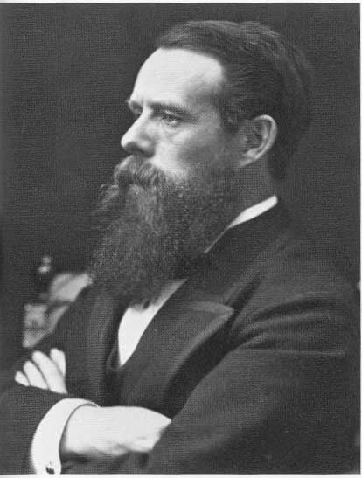
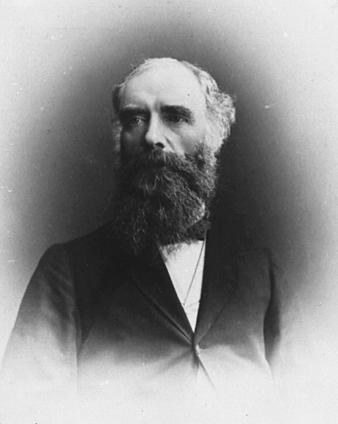
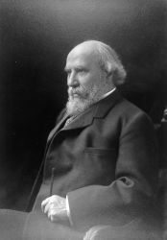
George Stephen
Bank of Montreal
Donald Smith
HBC
James J. Hill
Railway Investor
The government gave the CPR contract to a new syndicate, The syndicate received 25 million dollars, 25 million acres, a 20 year monopoly on railway building in the west, and a tax exemption. In return, they promised to finish the CPR within 10 years.

Slide 9
Planning the route
Originally the rail would go through Saskatoon and Edmonton
Land speculators bought up land near rail line
Syndicate wanted total control of the land near railroad
Syndicate moved rail line 300km south
Made prior survey useless
But now have to cross Monashee and Selkirk Mountains

Slide 11
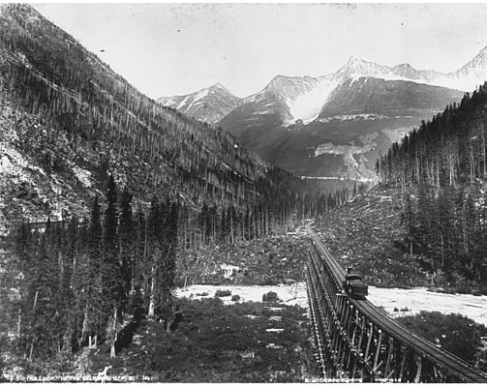
CPR in the Selkirk Mountains

Slide 12
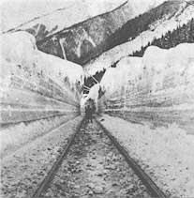
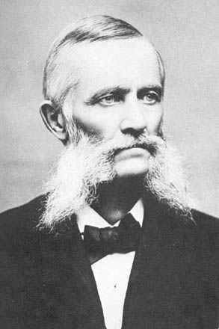
In 1882, Major A.B. Rogers discovered a pass through the Selkirk Mountains.
He was awarded $5000 bonus, and the pass was given his name.

Slide 13
10 Year goal hard to meet
Construction began 1881
construction was extremely challenging
very hard rock that took lots of blasting
muskeg soil swallowed up the track like quicksand.
By years end only 230km built

Slide 14
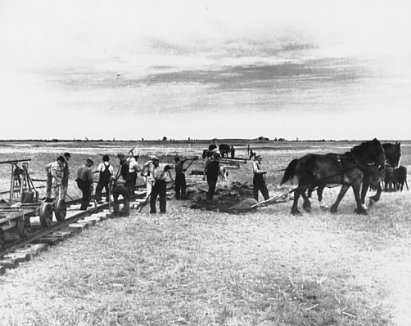
Laying track on the prairies

Slide 15
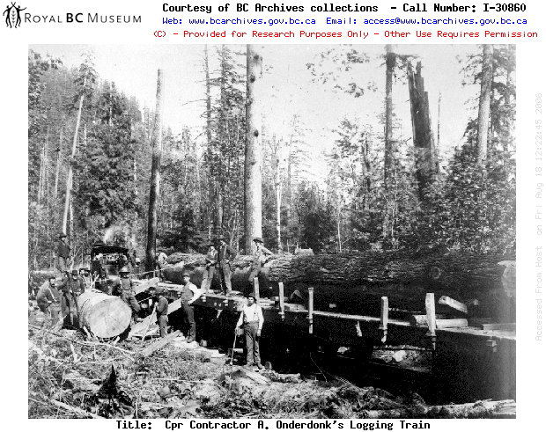
Building the CPR through thick BC forest

Slide 16
William van horne
General Manager
1000 miles of railway tract were laid during the 1882-1883 period.
The CPR would complete the railway in the contracted period

Slide 17
Money troubles
CPR Syndicate only paid after section built
By 1883 Running out of Cash
BC yet to be built
Stephen and Smith pledged their entire fortunes but not enough
1884 Government gave another 22.5 Million
Not enough
Cheap labour required

Slide 18
Cash flow problem over!
The Northwest Rebellion Broke out 1885
The CPR saves the day
Troops arrive in just 5 days! Entire force in 10 days!
Proved the CPR was necessary to the government
July 1885, parliament provided the needed funds

Slide 19
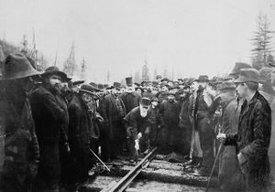
On November 7, 1885, Donald Smith drove the last spike of the CPR at Craigellachie.
Notice William Van Horne and Sandford Fleming standing behind Smith. This
famous photo was voted by the Beaver Magazine in 2008 as the #1 picture in its
“Photos that Changed Canada” contest.

Slide 20
The true cost of unification
The CPR was build by 1000s of workers entirely by hand
Majority Chinese workers
Terrible conditions
dust from the dynamite blasts
shack houses
Unhealthy diet
no medical facilities
Dangerous work!

Slide 21
“Every kilometer of tunnel and track was stained with blood along the British Columbia section of the line”

