Slide 1
The Northwest Mounted Police
Creation of the NWMP, Cypress Hill Massacre, The Great March

Slide 2
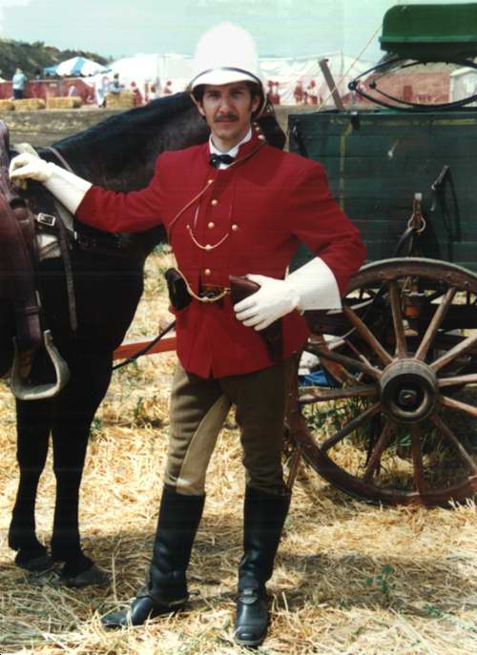
Creation of the nwmp
1873 the Canadian government created the NWMP
Enforced the law and established a Canadian presence in the region
Acted as a paramilitary force for the Northwest
Initially a positive force and positive relations with Aboriginals

Slide 3
The why?
Canadian Government is worried about two things:
the Americans will take over the territory and
the Americans will harm the First Nations who have already been affected by alcohol and disease.
a symbol of order, not liberty

Slide 4
Whiskey Trade
American traders selling whisky to Aboriginals
Without HBC controlling the area, American traders, who competed with the HBC, cross the border and trade with First Nations
Trading cheap “rotgut” whiskey for valuable buffalo robes, furs, horses, food
Traders took advantage of Aboriginals by fostering addiction
Drinking led to alcoholism, violence, malnutrition, and interfered with traditional hunting and food-gathering
NWMP sent in so to stop the trade, remove American threat of Whiskey and expansion

Slide 5
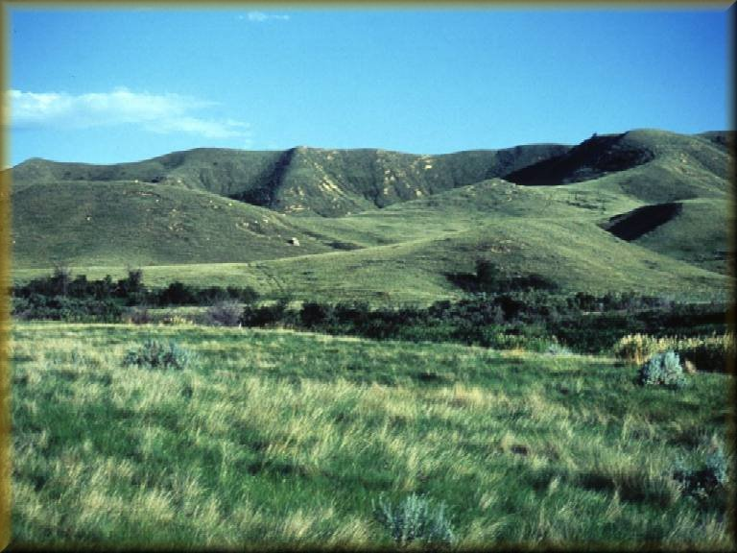
Cypress Hills Massacre 1874
American wolfers (getting their name from their profession- poison buffalo pelts so that wolves would eat them, die and then the Wolfers could sell the wolf pelts) were camping outside of the border.
In 1874, the Assiniboine First Nations people had a major problem with whiskey traders at Cypress Hills in present-day Saskatchewan.

Slide 6
The American traders suspected a group of Natives of stealing some of their horses, and they retaliated by killing thirty Assiniboines.
This massacre caused great concern throughout Canada and prompted the NWMP to step up their efforts to clear the prairies of American traders.
The American press in Montana hailed the men as heroes but such conflict enraged Eastern Canada and further prompted MacDonald to send a force out West

Slide 7
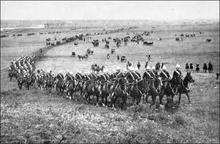
The great march 1874
An effort to establish order in the lawless prairies after the news of Cypress Hill broke in Eastern Canada
- March from Winnipeg westward to Fort Whoop-Up and other major centers like Fort Edmonton
The NWMP force was composed of 300 men from Ontario and Manitoba.
They underwent vigorous training in Winnipeg late 1873-74
Their job was to suppress the whisky trade and bring law and order to the West. It was their duty to protect the First Nations groups.

Slide 8
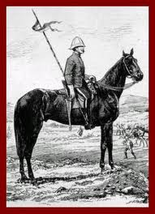
Problems in the great march
Travelled 2000km in summer heat
Low on rations, intense heat, lonely, isolated, dangerous terrain
Many men were not prepared to face the conditions of the march and deserted the group.

Slide 9
Arrived at fort whoop-up
First Nations groups were starving
American traders had fled
The First Nations, for a time, welcomed the presence of the NWMP (This would soon change)
Continued to patrol the North-West Territories for the next 30 years

