Slide 1
Chapter 5 The Prairies
The Métis Move West

Slide 2
Manitoba Act 1870
Manitoba became an official province of Canada in 1870.
Much of the Manitoba Act was based upon the Métis List of Rights
Compare the Métis List of Rights to the Manitoba Act: What did the Métis get from the Manitoba Act?

Slide 3
Under the Manitoba Act:
English and French would both be official languages
both Protestant and Catholic schools
566, 580 hectares (1,400,050 acres) of prairie farmland was put aside for the “children of the Métis,” and the rights of the Métis to their existing lands were protected.
(Only supposed to be 200 000 hectares)

Slide 4
Manitoba
The Canadian government purposefully made Manitoba very tiny compared to how big it is today.
It was nicknamed “the postage stamp province”
The white government was reluctant to give the Métis any more than the bare minimum of land. They wanted it saved for white settlers.

Slide 5
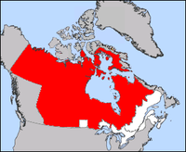

Slide 6
Manitoba was not as good as it appeared
Under the control of the Federal Government
Ended the Provisional Government and Métis representation
Macdonald sent troops to Keep the Peace
Troops were mostly Militia from Ontario and members of the Orange Order
Militia not peace keepers- want to avenge Thomas Scott
Métis assaulted and murdered, no Militia man was ever punished

Slide 7
Group work: Métis in Manitoba block 1
1. Hannah, Kevin, Brandon, Summer
2.Ashlie, Carly, Daniel, Will, Ted
3. David, Nick, Emma, Rachel, Kyleigh,
4. Kieran, Jaelin, Shanisse, Nathaniel

Slide 8
Group work: Métis in Manitoba block 2
1.Indigo, Ryan A., Carter, Bryn, Risa
2. Megan R., Leah, Max, Amy, Liam
3.Jaden, Cole, Olivia, Alycia, Katrina
4. Briana, Sarah, Mellissa, Ben, Ryan C.
5. Daisy, Meaghan B., Joseph, Chloe, Colton

Slide 9
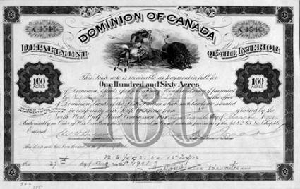
The Issue of land: Manitoba scrip
In order to gain title to the land reserved for them, the Métis in Manitoba were required to have scrip
Each family granted a scrip
a piece of paper similar to money
2 Kinds of Scrip
Money or land scrip
Value of $160 and $240 based on value of farmland
Money scrip could be converted to cash
Land scrip could be sold or exchanged fro a homesteader’s land grant

Slide 10
Problems with the scrip
Many of the Métis were cheated out of their scrips by land speculators who took advantage
Most Métis:
did not understand the importance of the document.
did not understand that paper documents actually proved land ownership.
could not read or write.
had oral traditions…not written.

Slide 11
Problems with the scrip
Scrips not issued until late 1875 due to slow land surveys
Adult Métis got $160, Children $240
Children’s land hard to farm
Open Prairie land 6km away from the river
Land distributed by lottery, and recipients had no control over where land grant was located

Slide 12
Land Speculators
Land speculation became a problem when combined with the scrip
The provincial government clearly supported the speculators and pressured the Métis to sell their scrip
- Militia intimidate Métis into selling scrip
White speculators often cheated Métis into giving scrip away.
Manitoba legislature passed a law forcing Métis to sell scrip if white person wanted to buy it.
threatened prison terms to those who resisted

Slide 13
Métis move north and west
Frustrated Métis sell their land titles (scrips)
Militia intimidate Métis into selling scrip
Slow process of land distribution
Bison decreasing
Métis sold scrips cheap 30- 40$
Speculators bough cheap and sold for profit
By mid 1970s many Métis left Manitoba, some settled in present day Saskatchewan

Slide 14
Métis in the North west
Established traditional communities
Farms laid out in traditional patterns (lots about 200 meters across and 3 km long stretching from the river)
Economy based upon subsistence farming, hunting bison, and hauling freight for the HBC (company still operating, just not in charge)
Alarming Trend- Bison disappearing
Main source of food and trade
More to come

