Slide 1
The Colony of Vancouver Island
Royal Navy, James and Amelia, Douglas Treaties

Slide 2
1848 Crown Colony of Vancouver Island
Gov needed an official British presence on Pacific Coast
Colony created to solidify claim

Slide 3
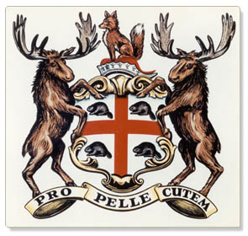
HBC 1848
Britain gave HBC trade monopoly
$$$$$$$$$$$$$$$$$$
HBC could sell land to Europeans or Americans who immigrated to the colony

Slide 4
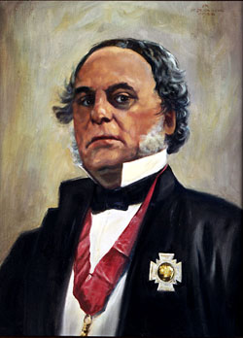
Douglas: A History
“Father of BC”
Protected British sovereignty
Decisions regarding First Nations and their land
building of Cariboo Road

Slide 5
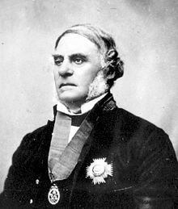
James Douglas
1851 Appointed Governor
Also Chief Factor of Fort Victoria
New position soon led to a conflict of interest
Difficult to address needs of both company and colony

Slide 6
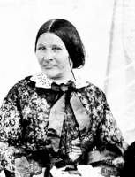
Amelia Douglas
Daughter of Cree woman and NEC Factor
Married James at 16
13 children!
Diplomatic talents helped James with First Nations and Métis
Story time page 211

Slide 7
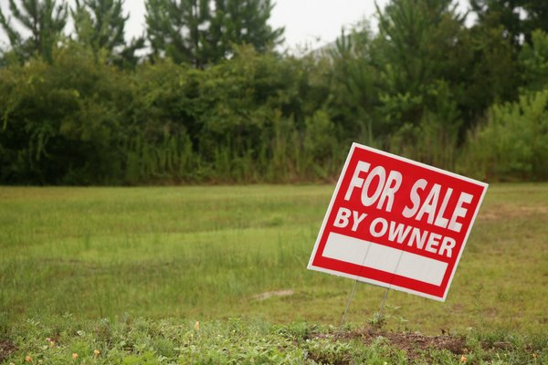
Land for Colonists
Douglas suggested free land be offered to colonists
British government decided to charge for the land
$5 per acre
Min. purchase of 20 acres

Slide 8
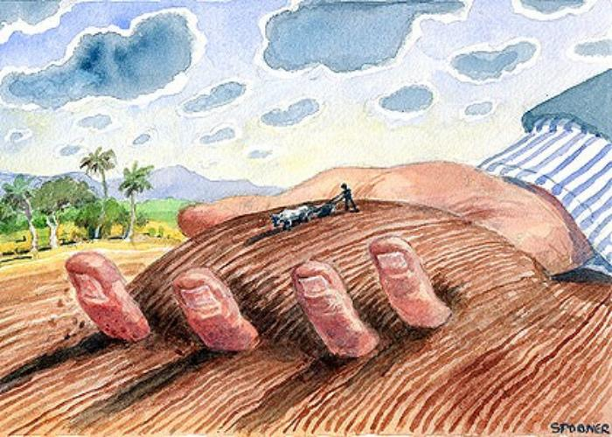
However
Most of the best land had already been purchased by the HBC and/or its employees
- Including Douglas!

Slide 9
Douglas convinced the British government to put a naval base near Fort Victoria
-to protect colony claim and coal mines discovered nearby
Became important to the emerging social life of Fort Victoria since the aristocratic naval officers were in demand at social functions such a as balls

Slide 10
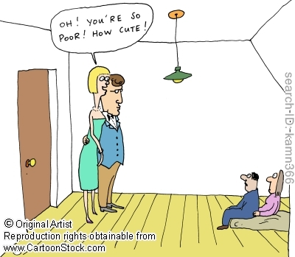
Social Class Divide
Douglas and most HBC employees had Métis or First Nation Wives
- Women often shunned by prejudice newcomers

Slide 11
The Douglas Treaties
Douglas knew that that the British needed to officially gain land title to First Nations land
Only way European colonization would work
Decided to negotiate
14 treaties between 1850-1854

Slide 12
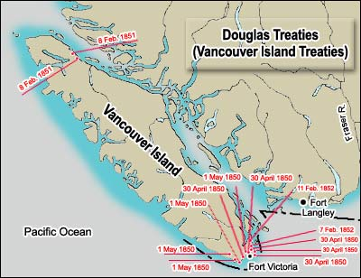

Slide 13
Douglas Treaties: A Better Way☺
First Nations choose where their reserves would be and size
Surveyors instructed to include already established First Nations Villages
Land for cattle and horses included
Allowed traditional hunt/fish rights

Slide 14
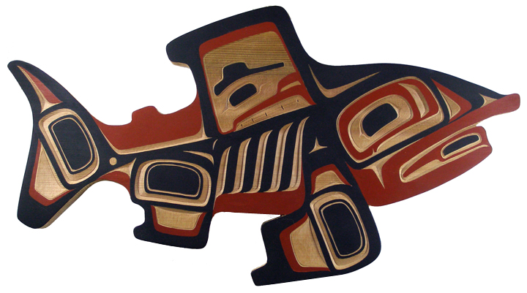
Aboriginal Title
Definition: the claim by Aboriginals that they have ownership of the land because they were first to occupy it
Douglas treaties acknowledged Aboriginal Title

