Slide 1
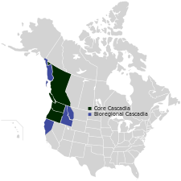
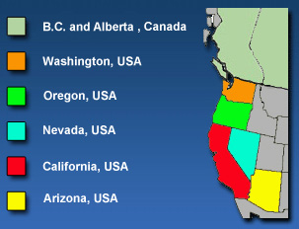
The West Coast of North America

Slide 2
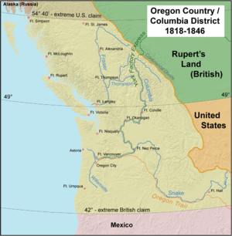

Slide 3
The Oregon Territory
HBC, US vs Britain, 54 40’ or Fight, 49th Parallel

Slide 4
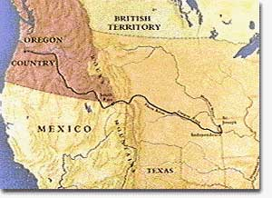
OREGON TERRITORY
1819
Britain and US agree to create border at 49th parallel
Land west of Rocky Mountains called Oregon Territory and shared by both nations

Slide 5
OREGON TERRITORY
The modern states of:
Oregon
Idaho
Washington,
BC
up to the border of Russian Alaska.
Both Great Britain and America claimed the territory.

Slide 6
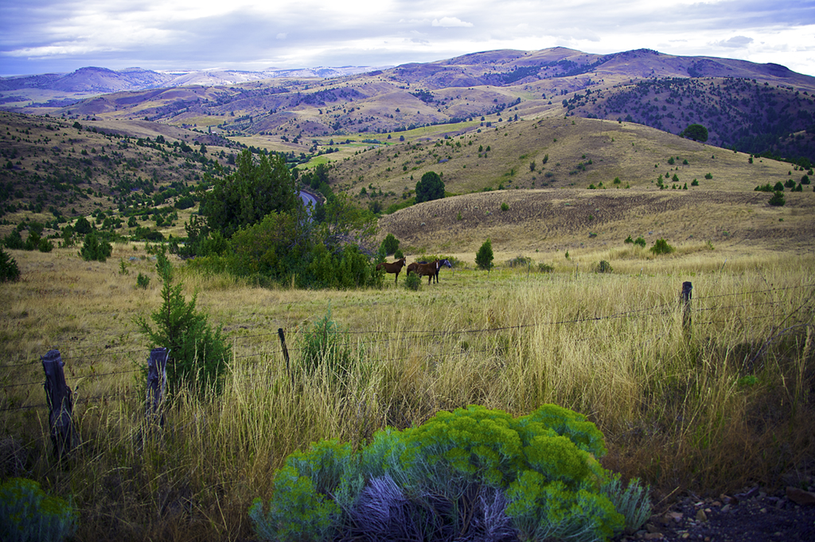
Why share the territory?
1819
Land sparsely populated
So no clear decision who should own territory
War of 1812 may have created fear of conflict

Slide 7
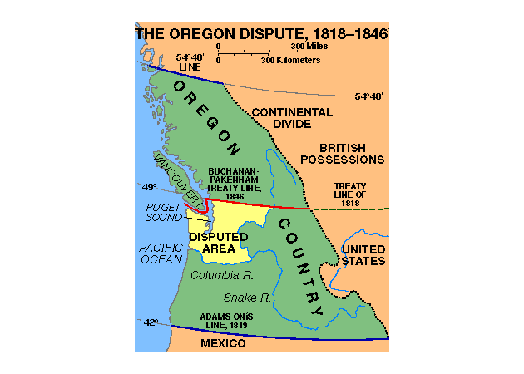
US in Need of Expansion
US facing rapid population increase
US government actively encouraged people in Eastern States to settle in Oregon territory
Most settled south of the Columbia River

Slide 8
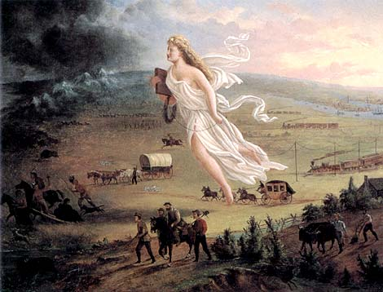
Manifest Destiny
Manifest Destiny
- the 19th century belief that the United States was destined, even divinely ordained, to expand across North America, from the Atlantic coast to the Pacific Ocean, by force if necessary.

Slide 9

HBC and the Oregon Territory
Already operating in the region
Saw it as a natural extension of Rupert’s Land
Did NOT encourage settlement
Only interested in the fur trade
Settlers would scare of animals
Settlers would undermine monopoly

Slide 10
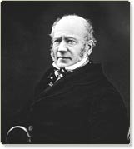
HBC Manager George Simpson
Believed the company was not making use of regions resources
1824 built a new trading post on the North bank of the Columbia River Called Fort Vancouver

Slide 11
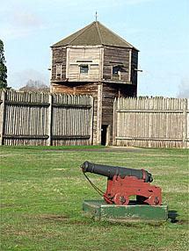
Fort Vancouver
Became the HBC’s main trading post in the Oregon Territory
Not in modern Vancouver
Located in Present day Washington

Slide 12
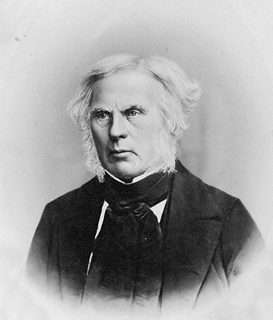
HBC Administrator John McLoughlin
Put in charge of Fort Vancouver
French Canadian
Directed to expand the fur trade along Pacific Coast
Wanted to limit American settlement and competition
Encouraged Americans to settle south of Columbia River
Gave supplies and money

Slide 13
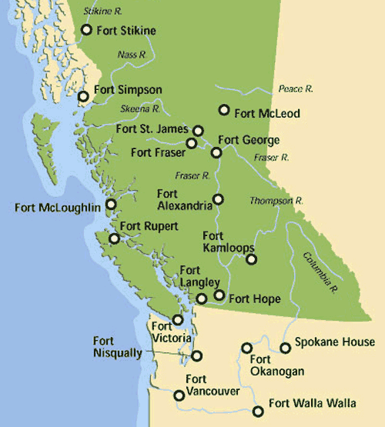
1841 Budget Cuts
Simpson disappointed at costal fur trade
Lack of expansion
Cut costs
All costal trade posts closed except Fort Simpson
Trade posts replaced with Steamship Beaver
- Trade with costal FN

Slide 14
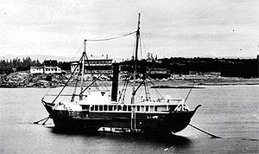
Steamship Beaver 1841

Slide 15
An Official Boundary Needed
Both US and Britain recognize need for boundary
Rising population of Americans on Oregon Territory
If 49th parallel extended form Rockies to Pacific Ocean?
- Fort Vancouver in US territory

Slide 16
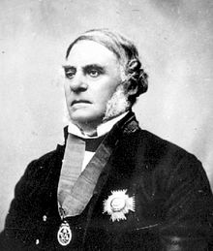
Chief Factor James Douglas
Fort Vancouver Chief Factor
1843
Simpson orders Douglas to build new trade post on Vancouver Island
New site Fort Victoria

Slide 17
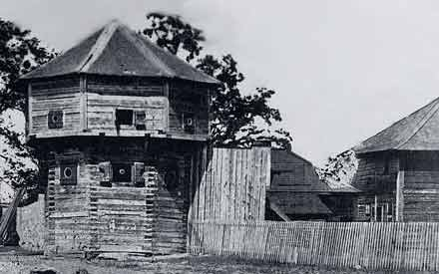
FORT VICTORIA

Slide 18
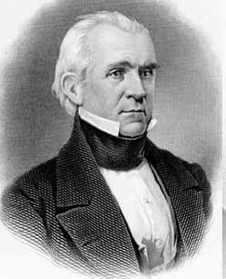
“54 40’ OR FIGHT”
1844 Democrat James K. Polk became president
Campaign slogan declared that Oregon territory should go to the US
“54-40 or fight!”
Never intended to go to war- Bluffing!

Slide 19
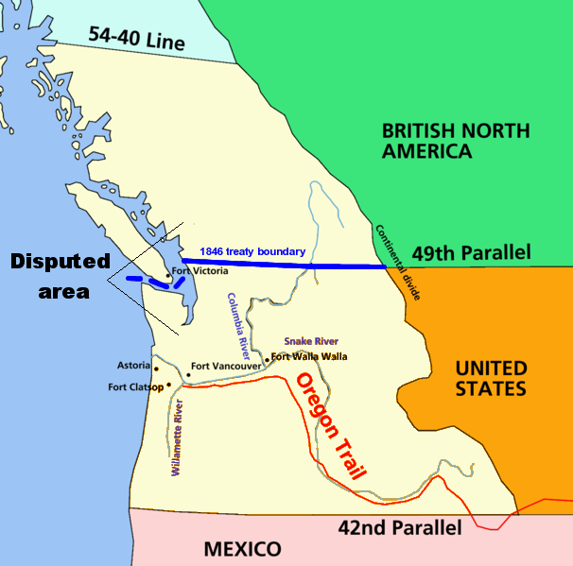
The Official Boundary
Negotiations 1845-46
49TH Parallel extended
Except Vancouver Island
Douglas spent next years transferring operations to Fort Victoria
Fort Vancouver officially closed 1849

